Slide 1

M108- Capstone Project Rain Prediction using classification Models Name Rajinder Kaur Student ID:- 0777816

Slide 2
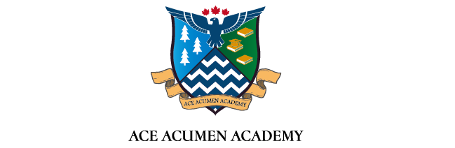
ABSTRACT
My dataset is about rain in Australia, this dataset contains about 10 years of daily weather observations from many locations across Australia. This dataset contains 145460 records and 23 attributes. ‘Rain Tomorrow’ is target variable to predict, that provide information about “will it rain tomorrow, Yes or No?”. Our dataset contains 1 Date/Time attribute that contains particular date of each observation with year and month, 6 categorical attributes such as Location that elaborates different location in Australia. RainToday which provides logical information about present day rain prediction, RainTomorrow shows the distribution regarding whether it will be raining tomorrow or not and contains 16 numerical attributes that are WindGustSpeed that shows the speed of wind gust in km/h, Pressure includes atmospheric pressure in hpa (hectro pascal pressure units).Then we perform initial analysis on our dataset. We will build different classification models to check their accuracy. We will also use Logistic regression, Random Forest, K-Neighbors and Naïve Bayes classifications models and choose an optimal model with highest accuracy score.

Slide 3
RESEARCH QUESTIONS:
Check yearly distribution of rainfall to find the years with highest and lowest rain fall.
Find out the degree of temperature that contains highest counts
Check the distribution of target attribute to evaluate will there be rain tomorrow or not?
Build different classification models and select an optimal model by comparing accuracies of all models.

Slide 4
Data Preprocessing
METHODOLOGY:-
Visualization of Numerical Attributes
Experimental Implementation:- Building Classification Model
Experimental Evaluation(Cross Validation)
Conclusion

Slide 5
Data Preprocessing

Slide 6
Attributes Names | Number of Missing Values
Sunshine | 69835
Evaporation | 62790
Cloud3pm | 59358
Cloud9am | 55888
Pressure9am | 15065
Pressure3pm | 15028
WindDir9am | 10566
WindGustDir | 10326
WindGustSpeed | 10263
Humidity3pm | 4507
WindDir3pm | 4228
Temp3pm | 3609
RainTomorrow | 3267
Rainfall | 3261
RainToday | 3261
WindSpeed3pm | 3062
Humidity9am | 2654
Temp9am | 1767
WindSpeed9am | 1767
MiniTemp | 1485
MaxiTemp | 1261
Data Preprocessing
Data Details
Missing Values
The null values in a dataset are known as missing values.
When no value is kept for any variable in an observation,
it is referred to as a null/missing or N/A value.
If null values are available in any dataset,
then our solution will never be accurate.
From Table, We can see that our dataset has enough missing
values in my dataset, so in order to undertake analysis,
we must erase these missing values from the dataset using
appropriate criteria. We get inaccurate output if we don't remove
these null values.

Slide 7
Exploratory Data Analysis

Slide 8
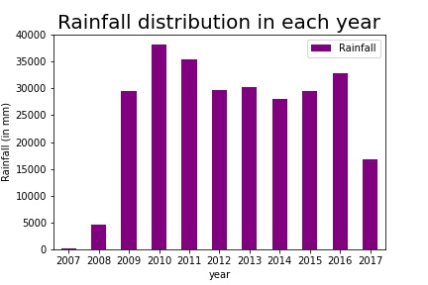
Yearly distribution of rainfall to find the years with highest and lowest rain fall
The graph above depicts the annual rainfall distribution, highlighting the year with the most and least rain throughout the course of the whole time. We can observe that the wettest years were 2010, 2011, and 2016, with about 33000mm of rain. The wettest years were 2007, 2008, and 2017, with rainfall ranging from 25000 to 30000 mm in 2009, 2012, 2013, 2014, and 2015.

Slide 9
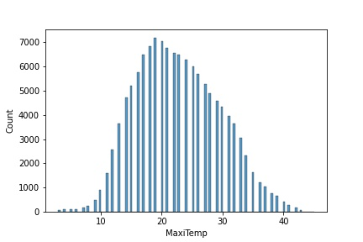
The degree of temperature that contains highest counts
The histogram shows normal distribution of maximum temperature and it's right skewed as most of the data frequencies are distributed towards right side and peak lies at left. The highest concentration of points of temperature is between 17 to 20 degrees Celsius.

Slide 10
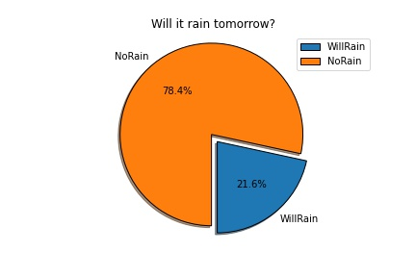
The distribution of target attribute
The distribution of the goal variable 'Will it rain tomorrow?' is represented by the pie chart above, which has two slices: 'Yes' (Will Rain) and 'No' (Will Not Rain) (No Rain). The graph shows that the chances of raining tomorrow are quite low, since yes only accounts for 21.6 percent of the total, while no accounts for 78.4 percent. As a result, it is apparent that pouring tomorrow will have more implications.

Slide 11
CORRELATION
The heat map above depicts the relationship between numerical attributes. We can observe that 'Temp9am,' 'Temp3pm,' and 'MaxiTemp' are all highly correlated, implying that they almost provide the same data. As a result, one of their attributes must be removed. For eliminating strongly correlated attributes, we can use two criteria: first, we can delete an attribute that has more missing values; second, we can examine the variance and remove any attribute with a variance that is close to 0. I had already deleted null values in my case so that we could verify the variance.

Slide 12
Correlation between Target and other attributes
Attributes Names | Column 1
RainTomorrow | 1
Humidity3pm | 0.447
Humidity9am | 0.254
Rainfall | 0.228
Temp3pm | 0.181
MaxiTemp | 0.146
MiniTemp | 0.095
WindSpeed9am | 0.077
WindSpeed3pm | 0.071
Temp9am | 0.011

Slide 13
VARIANCE
We can observe from the below table that the closely associated qualities 'Temp9am,' 'Temp3pm,' and 'MaxiTemp' have variances near to zero. As a result, I opted not to remove any of their attributes. Furthermore, there was no discernible difference in the outcome when I removed an attribute with low variance from the mix.

Slide 14
Attributes Names | Number of Missing Values
MiniTemp | 39.762
MaxiTemp | 47.078
Rainfall | 63.975
WindSpeed9am | 65.335
WindSpeed3pm | 62.146
Humidity9am | 331.57
Humidity3pm | 410.27
Temp9am | 40.1551
Temp3pm | 45.217
RainTomorrow | 0.169570011

Slide 15
Experimental Design

Slide 16
Separating input and target variable
Now we need to select attributes as input and target. In this, we created two variables; ‘X’ and ‘y’ and assigned attributes to them. In X we stored all the input (independent) variables and in y we stored our target attribute.
Train and test split approach
To avoid overfitting and appropriately evaluate our models, the data set is divided into two portions in this step: training and testing. When machine learning algorithms are used to make predictions on any data, the train-test split technique is employed to measure their performance. The train set contains 70% of the total data, while the test set only contains 30%.
Data Normalization
The rescaling or re-distribution of numerical data is referred to as data normalisation. Data normalisation is employed when our real data is not normalised, and it allows us to rearrange our data between the 0 and 1 range. To normalise our data, we utilise the Standard Scaler method, which removes the mean from each number and divides it by the standard deviation.
.

Slide 17
Classification models
We build four different classification models for getting accuracies such as Logistic regression, K- Nearest Neighbors, Naïve Bayes and Random Forest Classifier. We use logistic regression classification technique because our target variable has two possible outcomes (logical outcomes: yes and no). It is used to model the dependent variable. KNN fits best when our dataset has multiclass classification which means when data contains multiple classes. Naïve Bayes is used to make real time predictions and its fast and easy to understand. The Random Forest classifiers works better with complex and huge amount of data.
Cross validation
It is a technique for testing the efficiency of machine learning algorithm to Cross-Validation is a statistical method of evaluating and comparing learning algorithms by dividing data into two segments: one used to learn or train a model and the other used to validate the model.
K-folds cross validation
To reduce dataset bias, the K-folds approach is applied. It aids in the avoidance of overfitting. As we all know, the best performance accuracy is achieved when a model is trained using all of the data in a single session. To combat this, k-fold cross-validation aids in the development of a generalised model. We must divide the data set into two sets, Training and Testing, in order to do K-Fold Cross Validation. I divided each model into five folds at random to match the model, with the fifth fold being used to test the accuracy.

Slide 18
Stratified k-fold
Stratified K-Folds cross-validator. Provides train/test indices to split data in train/test sets. This cross-validation object is a variation of K-Fold that returns stratified folds. The folds are made by preserving the percentage of samples for each class. In this step, firstly I split the accuracy of each model and I find the accuracy of corresponding to each model. By comparing the all models with stratified K-fold I find that the accuracy
Repeated random test-train splits
With this strategy, I combine the k-fold cross validation method with traditional train-test splits, dividing the data into training and testing sets and using a cross-validation approach to split and test the algorithm multiple times. I divided the data into five random test-train splits that I repeated five times.

Slide 19
Experimental Implementation

Slide 20
Accuracy Matrix
Target Variable | Model Name | Train_Test_Split | kfolds_5 | Stratifiedkfold_5 | RRTestTrainSplits_5
0 | Logistic Regression | 74.21 | 80.28 | 83.98 | 82.90
1 | KNN | 71.54 | 66.59 | 73.85 | 73.79
2 | Naive Bayes | 77.45 | 68.52 | 72.29 | 72.30
3 | Random Forest | 74.81 | 90.05 | 89.73 | 90.07

Slide 21
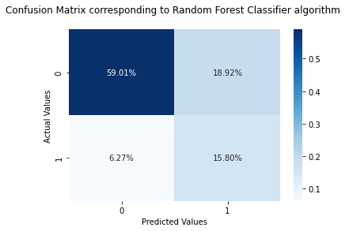
CONFUSION MATRIX CORRESPONDING TO RFC MODEL
The confusion matrix shows that correct predictions account for 58.44 percent of total proportions, while correction predictions account for 15.99 percent of total proportions. This is because when our predicted value is 0, actual values are also 0, and when predicted values are 1, actual values are also 1.

Slide 22
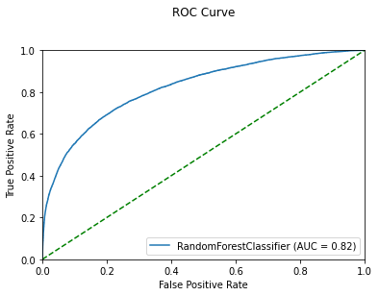
ROC CURVE CORRESPONDING TO AN OPTIMAL MODEL
The Receiver Operating Characteristics (ROC) curve is a probability curve with an AUC (Area Under Curve) that measures the degree of separability of certain qualities from one another. The AUC value indicates how well our model can distinguish between classes.

Slide 23
CLASSIFICATION REPORT CORRESPONDING TO AN OPTIMAL MODEL
Precision: The classification report shows corresponding to 0 there are 91% values were correctly predicted out of total predicted values and corresponding to 1 it is 45%. Recall: corresponding to 0, out of total actual values 75% are correct, whereas corresponding to 1, 72% values are correct.
Column1 | Precision | Recall | f1-score | support
0 | 0.91 | 0.74 | 0.81 | 29096
1 | 0.43 | 0.73 | 0.54 | 8017
accuracy |  |  | 0.73 | 37113
macro avg | 0.67 | 0.73 | 0.68 | 37113

Slide 24
Conclusion

Slide 25
In conclusion, we understand that the classification of models, we discovered that the 'Random Forest Classifier' is the best model for our dataset because it has the maximum accuracy. Our goal was to anticipate whether it would rain tomorrow or not. By looking at the distribution of the Target variable, we can see that there are very few chances of rain tomorrow because it makes up a small fraction of the total data. We also use K-fold, Stratified k-fold, and Repeated Random Train-tests to perform cross validation and determine that the RFC model has the maximum accuracy in each approach. The ROC curve also reveals that the AUC score is 0.82, indicating that our prediction of rain tomorrow was correct.

Slide 26


